Slide 1
BACKTRACKING ALGORITHM
Presented by:
Fatima Ehsan (BSCE21016)
Nimra Maqbool (BSCE21012)

Slide 2
TABLE OF CONTENTS
Backtracking and brute force approach
When to use Backtracking
Terminologies used in backtracking
Animation of backtracking
Examples
Time and space complexity

Slide 3
BACKTRACKING & BRUTE FORCE APPROACH
BRUTE FORCE APPROACH
Backtracking is an algorithmic technique where the goal is to get all solutions to a problem using the brute force approach. It consists of building a set of all the solutions incrementally. Since a problem would have constraints, the solutions that fail to satisfy them will be removed.
Find all possible solutions
Choose the most optimal one

Slide 4
WHEN TO USE BACKTRACKING?
Simplest algorithm:
backtrack(x)
if x is not a solution
return false
if is a new solution
add to the list of solutions
backtrack(expand x)
Normally it is used when you are faced with a number of options and have to choose one. After your choice, you have a new set of options (hence recursion). The procedure is repeated over and over until a final state.

Slide 5
TERMINOLOGIES USED IN BACKTRACKING
Live node:
E node:
Success node:
Dead node:
}
A
B
S
A
It can be generated into further nodes
B
C
D
}
Success node
A
E
B
}
S
A
Path from start to success
Dead nodes
B
Node leading to success/destination node
}

Slide 6
Animation of backtracking
.
B
Dead end
Starting Node
A
B
Start
A
D
C
C
Dead end
D
E
E
Dead end
G
F
Destination
reached
G
F
Dead end
Success Node
Success Node

Slide 7
Animation of backtracking
B
A
B
A
A
Path from start to success
Dead nodes
Start node
D
D
C
C
Success node
E node
E
E
E
G
G
F
G
F

Slide 8
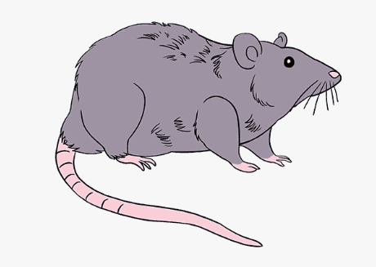
Rat in a maze example
Animation, code implementation & time/space complexity
Start
Destination

Slide 9
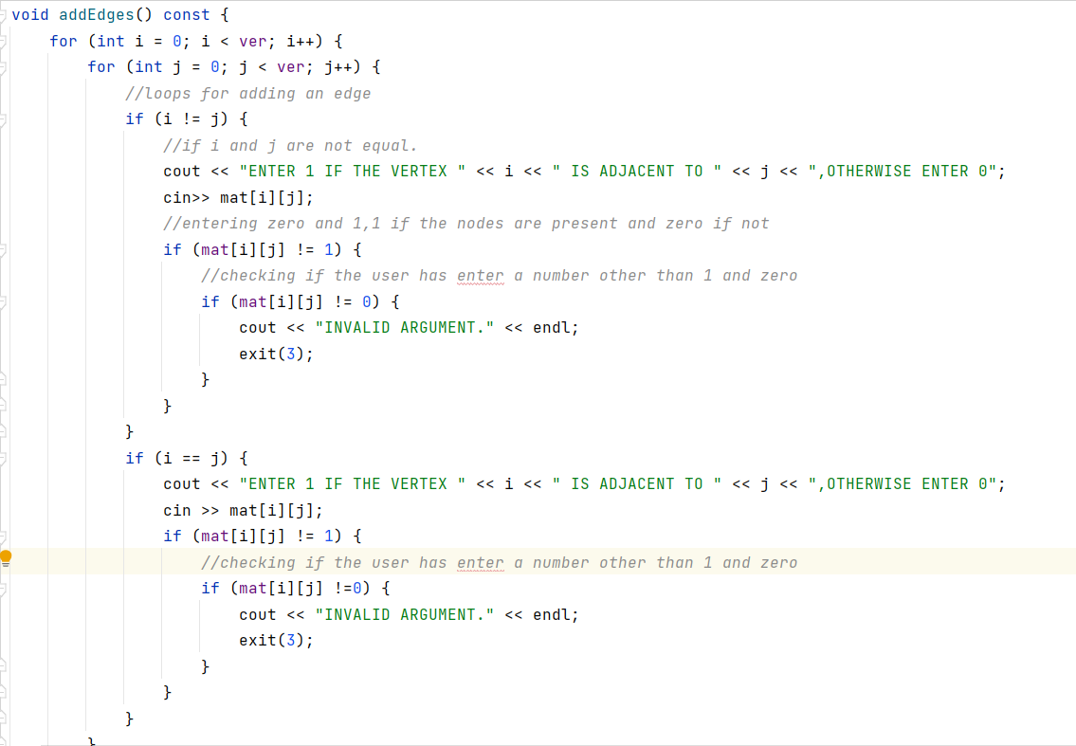
Code implementation

Slide 10
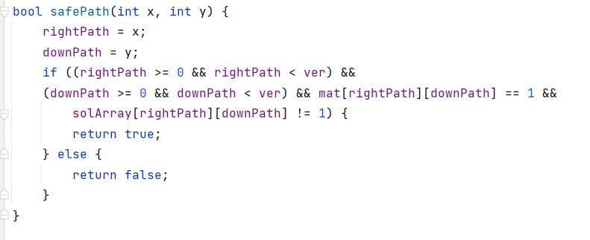
Code implementation (continued)
Function to find the safe path:

Slide 11
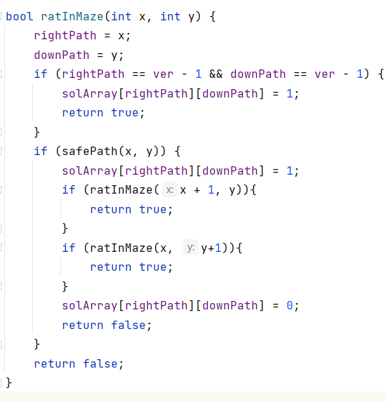
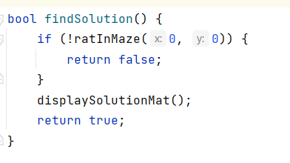
Code implementation (continued)
Function which returns the solution

Slide 12
Time & space complexity
->GRID OF N*N:
Best case time complexity is given below:
having 2 ways to move the rat = o(2^(n^2)).
space complexity = o(n^2).
having 4 ways to move the rat = o(4^(n^2)).
space complexity = o(n).
worst case time complexity = o(n^2).
->GRID OF M*N:
worst case time complexity = o(2^(m+n)).
best case time complexity = o(m*n).
space complexity = o(n).
average case time complexity = o(n(logn)).

Slide 13

N-Queen Problem
Animation, code implementation & time/space complexity
X
X
X
X
X
X
X
X

Slide 14
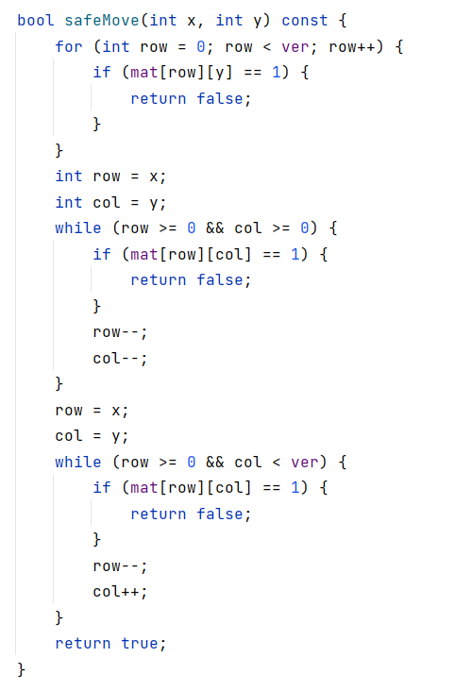
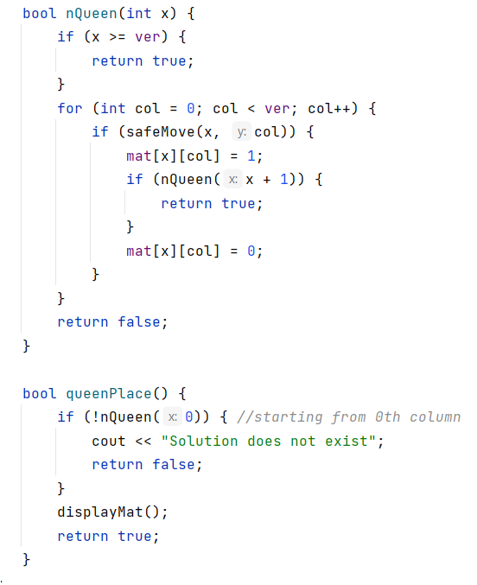
Code implementation

Slide 15
Time & space complexity
Time complexity = o(n!).
when n=4 , 4*3*2*1=4!.
The function safeMove(x,y) :n*T(n-1).
The function safeMove is called N times inside the function nQueen(x) function :O(n^2).
So total T(n) = n*T(n-1) + O(n^2).
The average case of time complexity = o(n!).
The worst case of time complexity = o(n!).
Space complexity = o(n).

Slide 16
THANK YOU!
------

